Slide 1

Internet Technologies
ITI & XI-IT
Lesson 1: GitHub
Henrik Lange

Slide 2
Agenda
Pre-assessment results
Buddy-arrangement
GitHub
What is Git and GitHub?
How does it work
Installation
Clone a repository
Make a branch
Commit changes
HTML & CSS

Slide 3
ITI Pre-assessment
We go over the results of the pre-assessment test
We have a quick discussion of level and expectations

Slide 4
Buddy Arrangement
Class is divided into review groups
Sizes depend on pre-assessment test
Everyone will review and comment on peer code
This lets you
See alternative approaches
Get help when you are stuck

Slide 5
What is Git and GitHub
Git is a distributed version control system
Allows for collaboration and change-tracking
Keep all revisions and go back
Branching and merging (more in a moment)
GitHub is a server that hosts Git projects

Slide 6
How does it work
Working Directory
Working directory is where you work
Remote contains all versions from every branch*
Repository is your local copy of the remote
Checkout
Commit
Local
Repository
Pull
Fetch
Push
Remote
Server

Slide 7
How does it work?
Git is a distributed version control system
Allows for collaboration and change-tracking
Keep all revisions and go back
Branching and merging (more in a moment)
GitHub is a server that hosts Git projects
Merge
Commit
Branch
Common base

Slide 8
Now what?
Everyone creates a GitHub account
Use SDU email address
Use SDU handle as GitHub username
Give me your username, and I will invite you to collaborate on the project
When you are invited, you will receive an e-mail with a confirmation link – click it and confirm

Slide 9
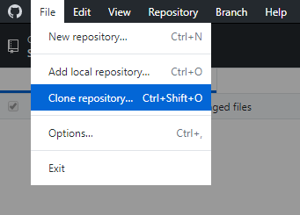
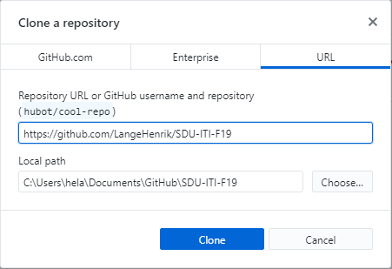
Clone repository

Slide 10
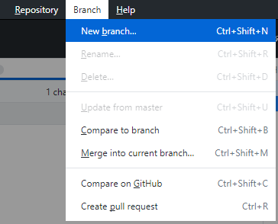
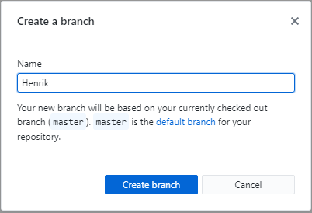
Create a branch

Slide 11

Create your own folder
GitHub Desktop has a shortcut to the repository folder:
Create a folder with the same name as your username/sdu handle
Inside the folder, create a text file, and write something in it
When you are done, go back to GitHub Desktop and commit your folder and file to your branch

Slide 12
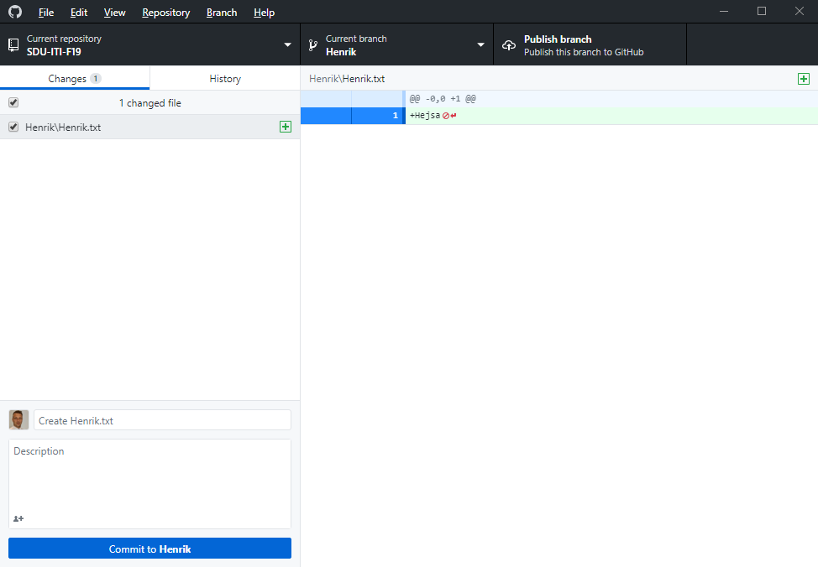
Commit your file to your branch
My branch
Changes in selected file
My changed files
Describe your changes
Commit your changes

Slide 13
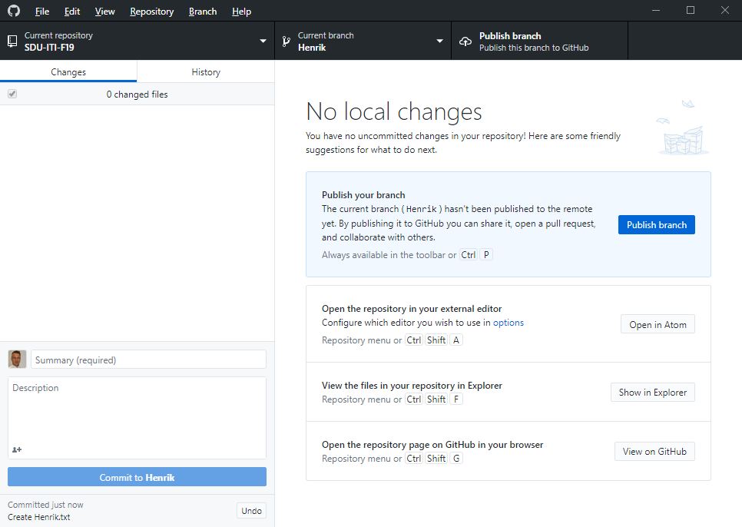
Commit your file to your branch
Publish you branch
Notice undo button!

Slide 14
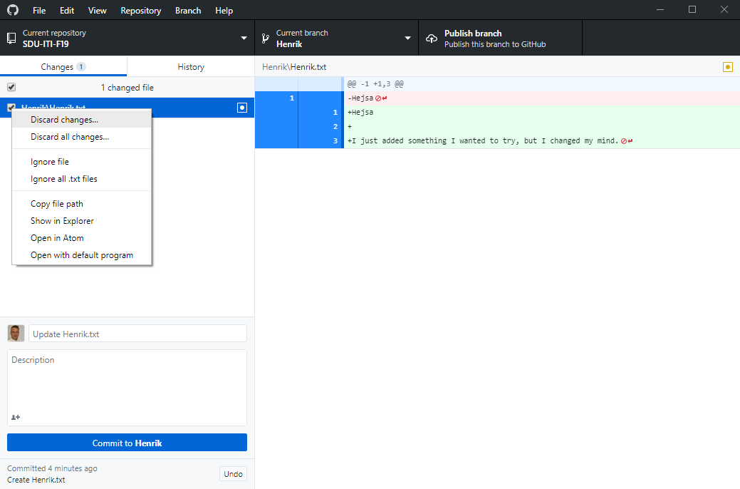
Commit your file to your branch

Slide 15
Why are we doing this?
This makes it fast and convenient for me to see your work and help you out
It lets your buddies look at your work equally fast and comment on it online
It lets you save your own work in versions, so you can go back or branch out when you want to try new things

Slide 16
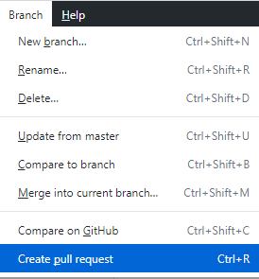
Pull requests
A pull requests signals that your want to update the master branch with the content of your own branch
When you create a pull request, a reviewer can see all changes since your last pull request and comment on them

Slide 17
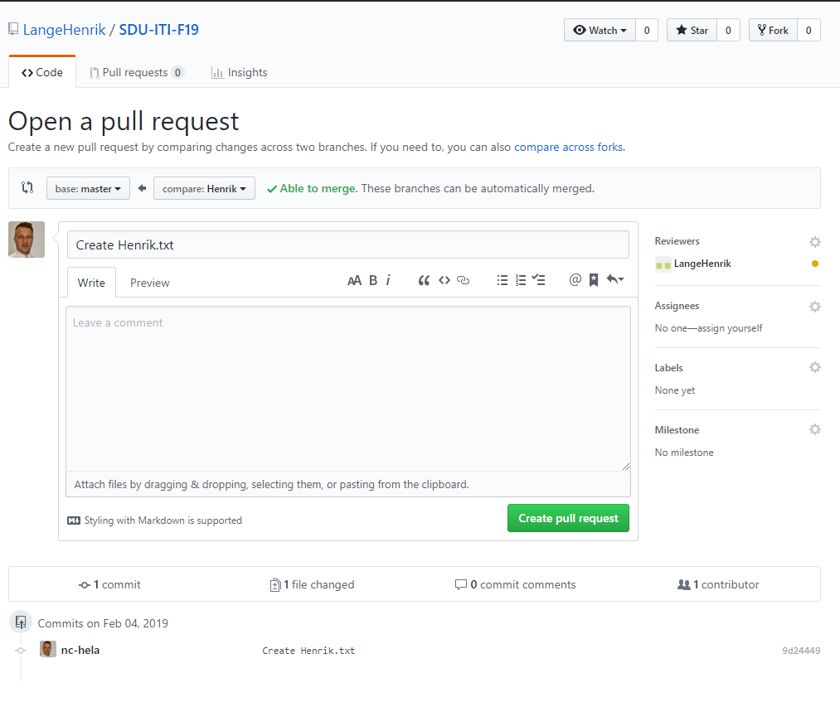
Pull requests
Select someone you want feedback from
Confirm your pull request

Slide 18
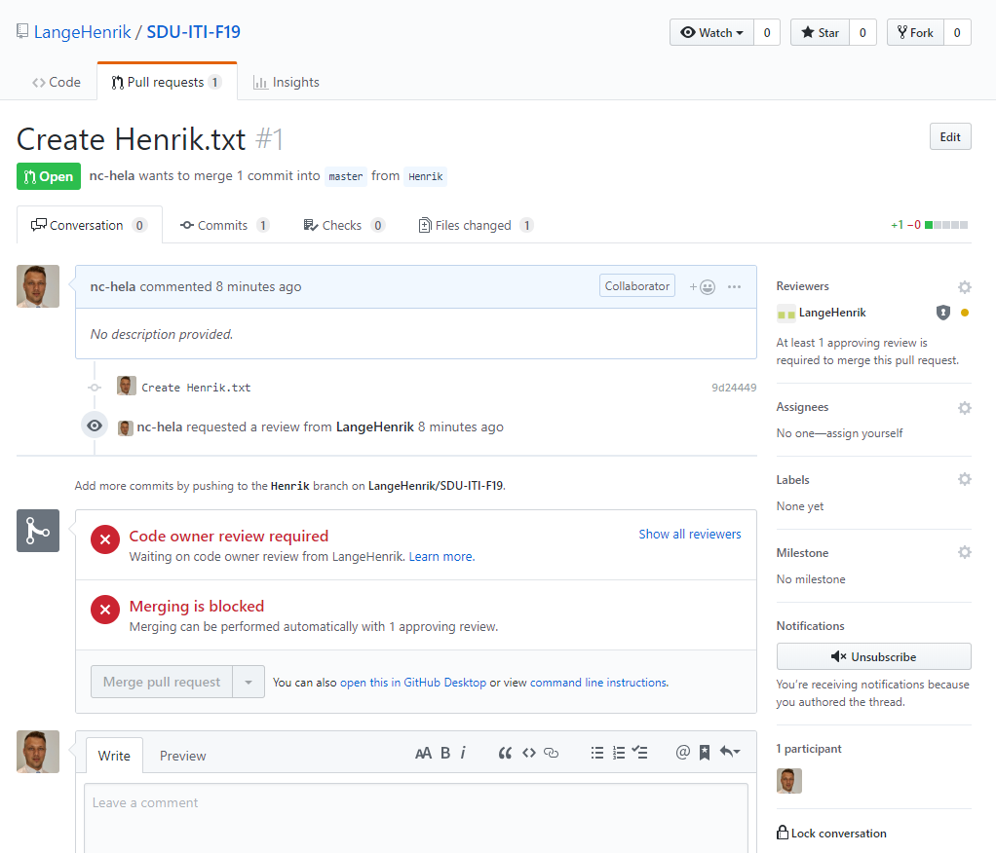
Pull requests
Pull request can only be merged when it is approved

Slide 19
House rules
I am the code owner, and therefore, I am the only one who can grant access to merge into the master branch
I will not approve unless someone else (your buddy) has already gone over the code, left comments and approved it.
When you want feedback, you must create a pull request
If you want feedback on something specific, write in the description of the pull request what you need
Only work in the folder with you own username, or I will not approve the PR.

Slide 20
Assignments
Assignments are handed in as PR at given deadlines, and after the PR is made, no further commits are made
If we need to handle assignments in BlackBoard, I expect the BlackBoard .zip file to be identical to your pull request
Feedback will be given in a personal email for the assignments
General problem solving will be handled with public comments

Slide 21
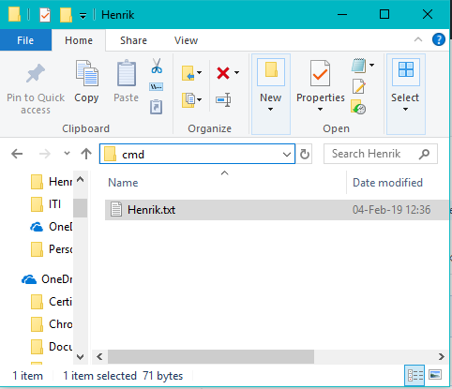
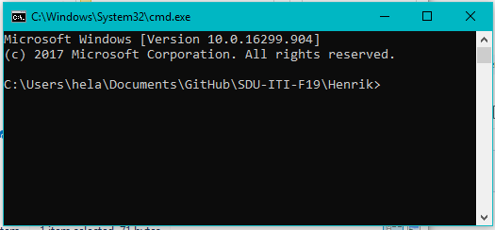
Nice to know
To disregard all commits and get back to master
git reset --hard master
To go to the command prompt of a folder, in windows, go to the folder in finder, and write cmd in the address field.

Slide 22
Questions
We try to keep this part of the course very brief, so we have only covered a fraction of Git and GitHub.
Feel free to ask any questions – now – or when you need to.

Slide 23
BREAK
Make sure these things work,
and afterwards, we will continue with:
HTML

